Slide 1
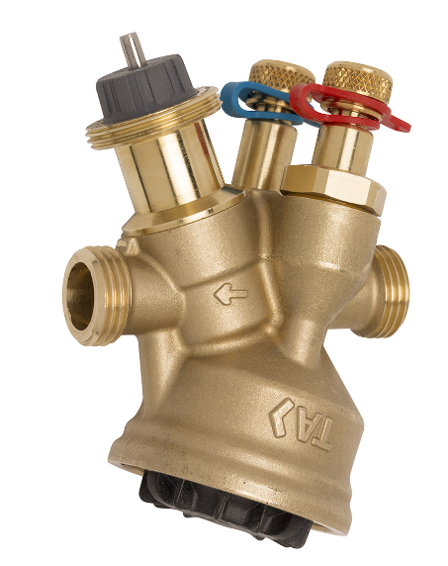
TA-Modulator the only integrated valve works in market

Slide 2
What is the ideal feature of control valve
The premise is The pressure drop of control valve should be constant
Heating/Cooling coil
Control valve
Control is easy
Notes:
该调节阀曲线为阀权度为1的时候的曲线

Slide 3
The feature of Coil/FCU/AHU
p%
The diagram of q% and p%
Δt=2.5 ºC
130
120
110
100
90
80
70
60
50
40
30
20
200% q
110% p
Only 2.5 ºC
We can use control vale to to regulate flowrate
Copyright © IMI Hydronic Engineering International SA. All rights reserved.
10
0
50 100
150 200
250
300
q %

Slide 4
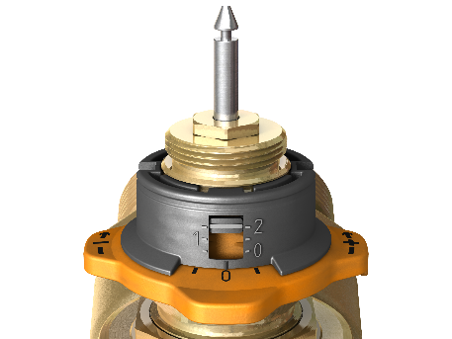
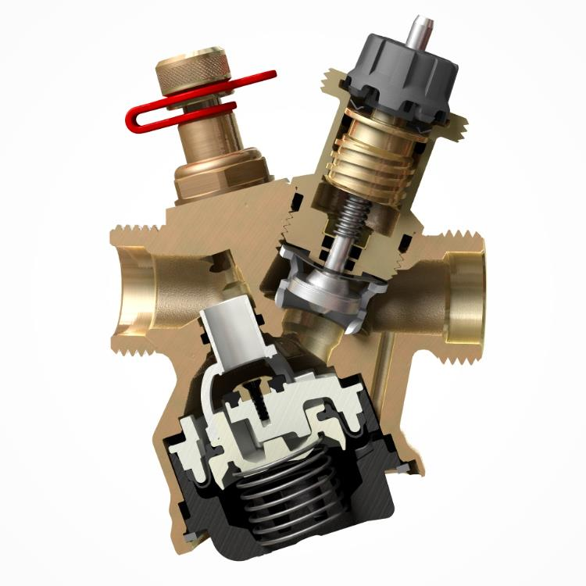
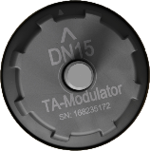
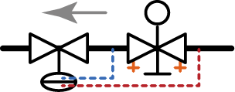
Here we are
Modulator=Static valve+ dynamic pressure valve +control valve
Notes:
For adjusting to a desired design flow rate, simply turn the setting wheel with your fingers to the setting value giving the flow according to flow/setting table or from HySelect or HyTools

Slide 5

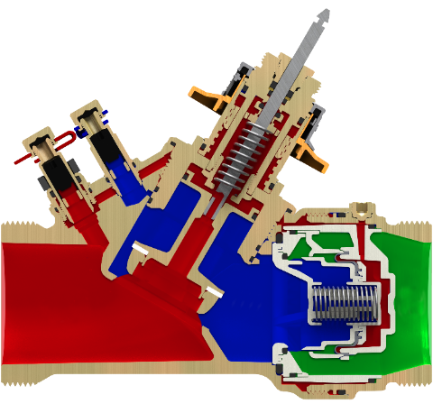
How it works
Pre-setting
ΔH
Pressures
ΔH = P₁ – P₃
Δp control plug = P₁ – P₂
Δp Dp-controller = P₂ – P₃
Measuring flow by measuring Δp P₁ - P₂(activated DpC)
Measuring ΔH by measuring Δp P₁-P₃ (deactivated DpC)
If P₁
Spring pressed
Channel narrow
P₂-P₃
p₁
p₂
p₃
P₂
P₁-P₂ almost unchanged
[DN 50]
The control is easy!!!

Slide 6
How it works
Pre-setting
ΔH
1.Pre-setting KV of Control valve to design flowrate
2.Measure Δp control plug(P1-P2) to Calculate the flowrate to make sure it equals to design flowrate
TA is the only one who can measure P1 and P2 so as to calculate the flowrate to adjust
p₁
p₂
p₃
[DN 50]

Slide 7
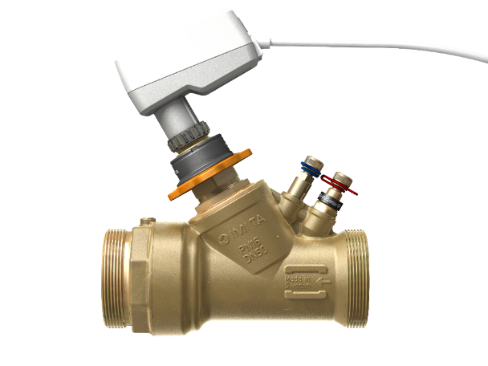
main features
Fits to all projects and BMS systems
New fully configurable digital actuator TA-Slider 500 fits to all BMS systems
True flow & pressure measurement
Full system optimisation with direct measurement of flow and available pressure.
Flexible connectivity male ISO 228 threads for multiple connections
Long life reliability
AMETAL®
Automatic Balancing
Accurate pressure independent flow limitation for automatic hydronic balancing and high control stability.
Precise flow control
thanks to EQM characteristic on a pressure neutralized control plug

Slide 8
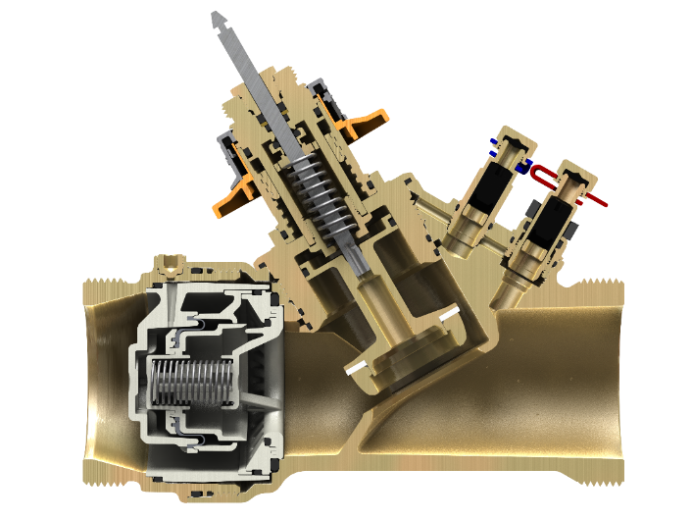
Some details
Pre-setting mechanism
Channel to transport p₁ to the Δp controller
Venting screw
p₁
Shut off function for the pressure channel. Normally open
p₁
p₁
Control plug shaped for EQM characteristic
p₁
Channel for pressure neutralized control plug
Inline Dp controller

Slide 9
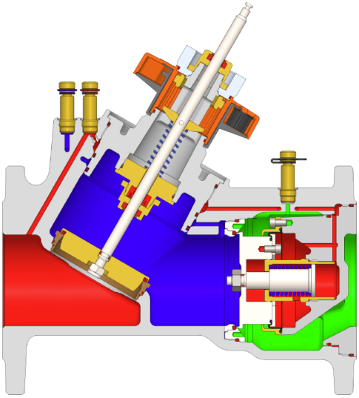
Some details
Pre-setting mechanism
Channel to transport p₁ to the Δp controller
Channel to transport p₂ to the PT port
Black PT port for measuring ΔH
Control plug shaped for EQM characteristic
Inline Dp controller

Slide 10
Thanks for your attention

